Slide 2
Build a Social News App with Android and AWS
MOB307
Min Bi
Software Development Engineer
AWS Mobile
@minbitweets
Nikhil Dabhade
Sr. Cloud Solutions Engineer
AWS Mobile
@in_nikoftime

Slide 3
Agenda
Architecture
Toolchain
Code

Slide 4
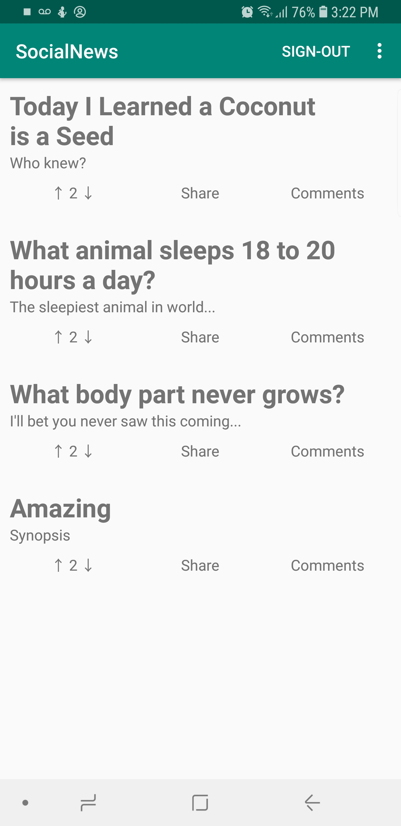
What are we building – A social news app
Add news article to feed
View the news feed
Comment on news articles
Authentication
Analytics

Slide 5
App requirements
Responsive
Cache for speed and offline
Efficient network usage
Data-driven UI updates

Slide 6
Application architecture
Activity
ViewModel
LiveData
LiveData
LiveData
Repository
Model
AWS
Room
AWS Mobile SDKs for Android

Slide 7

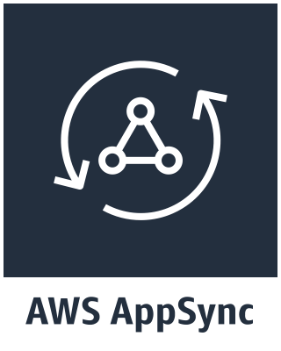







Cloud architecture
AWS Cloud
AWS Amplify CLI
Developer

Slide 8
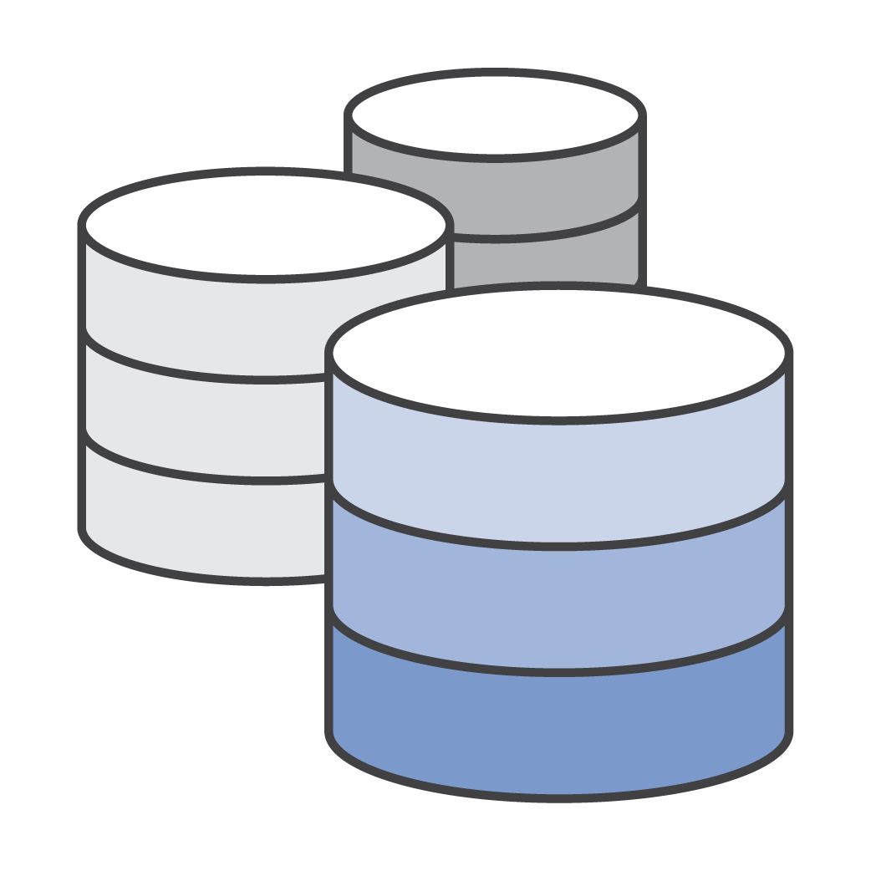





AWS AppSync
Managed Serverless GraphQL service
Connect to data sources in your account
Add data sync, real-time and offline capabilities for any data source or API
GraphQL façade for any AWS service
Conflict detection and resolution in the cloud
Enterprise security features: AWS Identity and Access Management (IAM), Amazon Cognito, OIDC, API keys

Slide 9




AWS AppSync
Clients receive the data they ask for. Nothing more, nothing less
Get many resources from many data sources with a single request
Self-documenting APIs with Introspection
React Native, Android, iOS, and Web (JS) using the Apollo GraphQL client
Data persistence across application restarts
Write-through mutations with Optimistic UI

Slide 10
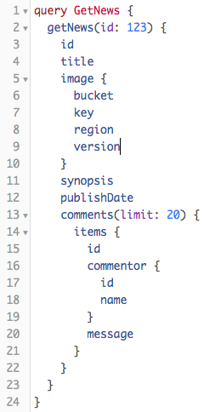
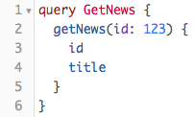
GraphQL
GraphQL call
Dynamic response shape

Slide 11
Go to the repository
https://bit.ly/reinvent2018android

Slide 12
Cloud architecture
AWS Cloud
AWS Amplify CLI
Developer

Slide 13
AWS Amplify CLI
What is AWS Amplify CLI?
Provisions backend resources
Configuration as code
What are we going to do with it?
Model data with GraphQL
Transpile the model into AWS CloudFormation
Minimal GraphQL knowledge required

Slide 14
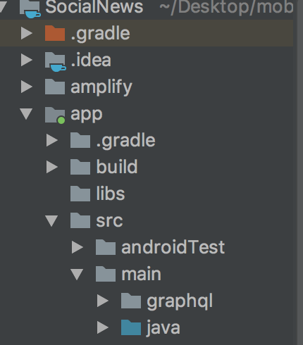
AWS Amplify CLI
amplify init

Slide 15
Cloud architecture
AWS Cloud
AWS Amplify CLI
Developer

Slide 16
Cloud architecture
AWS Cloud
AWS Amplify CLI
Developer

Slide 17
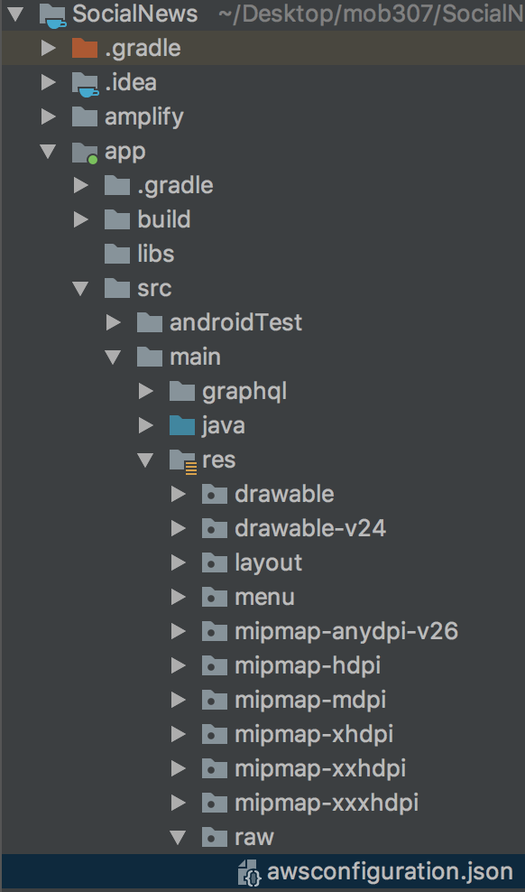
AWS Amplify CLI
"CredentialsProvider": { "CognitoIdentity": { "Default": { "PoolId": "us-east-1:xxxxxxxx-xxxx-xxxx-xxxxxxxx", "Region": "us-east-1" } } }, "CognitoUserPool": { "Default": { "PoolId": "us-east-1_xxxxxxxx", "AppClientId": ”xxxxxxxxxxxxxxxx", "AppClientSecret": ”xxxxxxxxxxxxxxxxxxxx", "Region": "us-east-1" } },
amplify add auth

Slide 18
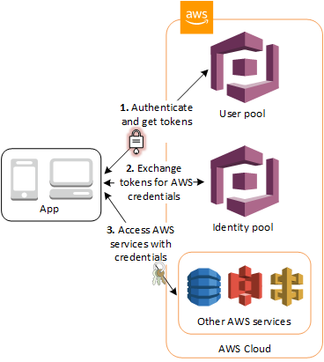
Sign-in with Amazon Cognito
Why is sign-in tough?
Identify your users
Elevate permissions
Personalize the experience

Slide 19
Sign-in code
AWSMobileClient.getInstance().showSignIn(this, new Callback<UserStateDetails>() { @Override public void onResult(UserStateDetails result) { Log.d(TAG, “onResult: “ + result.getUserState()); } @Override public void onError(Exception e) { Log.e(TAG, "onError: ", e); } });

Slide 20
Cloud architecture
AWS Cloud
AWS Amplify CLI
Developer

Slide 21
AWS Amplify CLI
"AppSync": { "Default": { "ApiUrl": "https://xxxxxx.appsync-api.us-east-1.amazonaws.com/graphql", "Region": "us-east-1", "AuthMode": "API_KEY", "ApiKey": "da2-xxxxxxxxxxxxxxxx" } },
amplify add api

Slide 22
AWS Mobile SDK for Android
GraphQL Actions
Query
Mutation
Subscription
Features
Selection sets
Offline cache
Complex objects
Notes:
Query – read
Mutation – any write operation
Subscription -

Slide 23
Query code
GetNewsQuery getNewsQuery = GetNewsQuery.builder().id(newsId).build(); client.query(getNewsQuery) .responseFetcher(AppSyncResponseFetchers.NETWORK_ONLY) .enqueue(new GraphQLCall.Callback<GetNewsQuery.Data>() { @Override public void onResponse(@Nonnull Response<GetNewsQuery.Data> response) { newsDao.save(news); } @Override public void onFailure(@Nonnull ApolloException e) { } });

Slide 24
Subscription code
OnCreateCommentSubscription newCommentsSubscription = OnCreateCommentSubscription.builder().build(); AppSyncSubscriptionCall<OnCreateCommentSubscription.Data> subscriptionWatcher = ClientFactory.getAppSyncClient().subscribe(newCommentsSubscription); subscriptionWatcher.execute(
new AppSyncSubscriptionCall.Callback<OnCreateCommentSubscription.Data>() { @Override public void onResponse(@Nonnull Response<OnCreateCommentSubscription.Data> response) { } @Override public void onFailure(@Nonnull ApolloException e) { } @Override public void onCompleted() { } });

Slide 25
Cloud architecture
AWS Cloud
AWS Amplify CLI
Developer
Notes:
Let’s take a look at how we are going to achieve this with the architecture of the system.

Slide 26
AWS Amplify CLI
"PinpointAnalytics": { "Default": { "AppId": ”xxxxxxxxxxxxxxxxxxxxxxxx", "Region": "us-east-1" } }, "PinpointTargeting": { "Default": { "Region": "us-east-1" } },
amplify add analytics

Slide 27
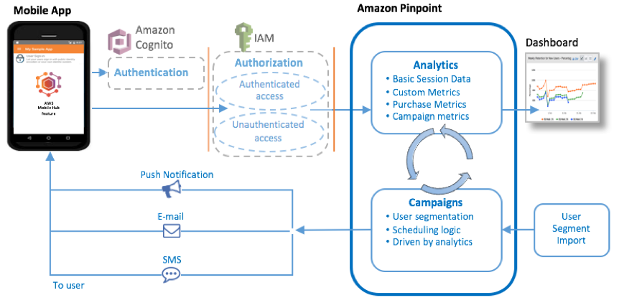
Analytics
Learn about your users
Engage your users

Slide 28
Analytics code
ClientFactory.getAnalyticsClient().recordEvent( ClientFactory.getAnalyticsClient().createEvent("ui").withAttribute("clicked", "newsId-" + newsId) );

Slide 29
Analytics console
amplify analytics console

Slide 30
Local architecture
Store the data
Keep the data up to date
Prevent memory leaks
Push updates to the UI

Slide 31
Application architecture
Activity
ViewModel
LiveData
LiveData
LiveData
Repository
Model
AWS
Room
AWS Mobile SDKs for Android

Slide 32
Room database
@Database(entities = {News.class}, version = 1, exportSchema = false) public abstract class NewsDatabase extends RoomDatabase { public abstract NewsDao newsDao(); }

Slide 33
Room DAO
@Dao public interface NewsDao { @Insert(onConflict = REPLACE) void save(News news); @Insert(onConflict = REPLACE) void save(List<News> news); @Query("SELECT * FROM news WHERE id = :newsId") LiveData<News> load(final String newsId); @Query("SELECT * FROM news") LiveData<List<News>> list(); @Query("SELECT * FROM news ORDER BY publishDate DESC") LiveData<List<News>> listByNew(); }

Slide 34
Room entity
@Entity(primaryKeys = "id") @TypeConverters({DataConverter.class}) public class News { @NonNull private String id; private String title; private String synopsis; private String content; private long publishDate; private List<Comment> comments; // Constructurs, getters, and setters

Slide 35
Application architecture
Activity
ViewModel
LiveData
LiveData
LiveData
Repository
Model
AWS
Room
AWS Mobile SDKs for Android

Slide 36
Repository
@Singleton public class NewsRepository { private final NewsDao newsDao; private AWSAppSyncClient client; public NewsRepository() { newsDao = Room.databaseBuilder(ClientFactory.getContext(), NewsDatabase.class, "news-database").build().newsDao(); client = ClientFactory.getAppSyncClient(); } public LiveData<News> getNews(final String newsId) { refreshNews(newsId); return newsDao.load(newsId); }

Slide 37
Repository
public void refreshNewsList() { Log.d(TAG, "Fetching from service, use TTL or other metric to determine staleness"); ListNewssQuery listNewssQuery = ListNewssQuery.builder().build(); client.query(listNewssQuery) .responseFetcher(AppSyncResponseFetchers.NETWORK_ONLY) .enqueue(new GraphQLCall.Callback<ListNewssQuery.Data>() { @Override public void onResponse(@Nonnull Response<ListNewssQuery.Data> response) {
newsDao.save(newsList); } @Override public void onFailure(@Nonnull ApolloException e) { Log.e(TAG, "Failed to refresh news item", e); } }); }

Slide 38
Application architecture
Activity
ViewModel
LiveData
LiveData
LiveData
Repository
Model
AWS
Room
AWS Mobile SDKs for Android

Slide 39
View model
public class NewsViewModel extends ViewModel { private LiveData<News> news; private NewsRepository newsRepo; public LiveData<News> getNews(final String newsId) { return newsRepo.getNews(newsId); } public LiveData<List<News>> getNewsList() { return newsRepo.getNewsList(); } }

Slide 40
Application architecture
Activity
ViewModel
LiveData
LiveData
LiveData
Repository
Model
AWS
Room
AWS Mobile SDKs for Android

Slide 41
View
public class MainActivity extends AppCompatActivity { @Override protected void onCreate(Bundle savedInstanceState) { super.onCreate(savedInstanceState); setContentView(R.layout.activity_main); viewModel = ViewModelProviders.of(this).get(NewsViewModel.class); viewModel.getNewsList().observe(this, newsList -> mAdapter.setNews(newsList)); }

Slide 42
What we learned today
Responsive
Cache for speed and offline
Efficient network usage
Data-driven UI updates
https://bit.ly/reinvent2018android

Slide 43
What we learned today
Serverless for scale
Respect the user
Analytics

Slide 44
Min Bi
bimin@amazon.com

